Slide 1

SmartPark: AI-Enhanced Parking System
TEAM MEMBERS :
AKARSHIT MISRA (21BAI1597)
DIVYANSH RAWAL (21BLC1123)
GUIDE NAME: Dr. S.BHARATHI RAJA (SCOPE)

Slide 2
INTRODUCTION
The growing need for efficient parking management in urban areas has led to the development of parking detection systems. Such systems aim to reduce time spent searching for parking, minimize traffic congestion, and optimize space utilization. These systems can be categorized based on the underlying technologies, including computer vision, and AI/ML models for predictive analysis.
Technological Advancements
Deep Learning for Image Processing: Deep learning models to analyze video feeds for real-time occupancy detection
Computer Vision for Parking Spot Detection: Use of computer vision techniques and AI algorithms to detect parking availability.
Predictive Analytics: Machine learning models that predict parking demand based on historical data.

Slide 3
Computer vision uses AI algorithms to analyze video feeds from cameras installed in parking lots. By employing object detection models like YOLO and Faster R-CNN, these systems can accurately identify and track vehicles in real-time, determining whether a parking spot is occupied or vacant.
Another powerful approach is predictive analytics, which leverages machine learning models to forecast parking demand based on historical data. By analyzing factors like traffic patterns, and special events, these models can help parking operators optimize pricing strategies, allocate resources efficiently, and anticipate peak demand periods.
Deep learning, particularly convolutional neural networks (CNNs), has significantly advanced the capabilities of parking detection systems. CNNs can extract intricate features from images, enabling accurate vehicle detection and classification, even under challenging conditions.

Slide 4
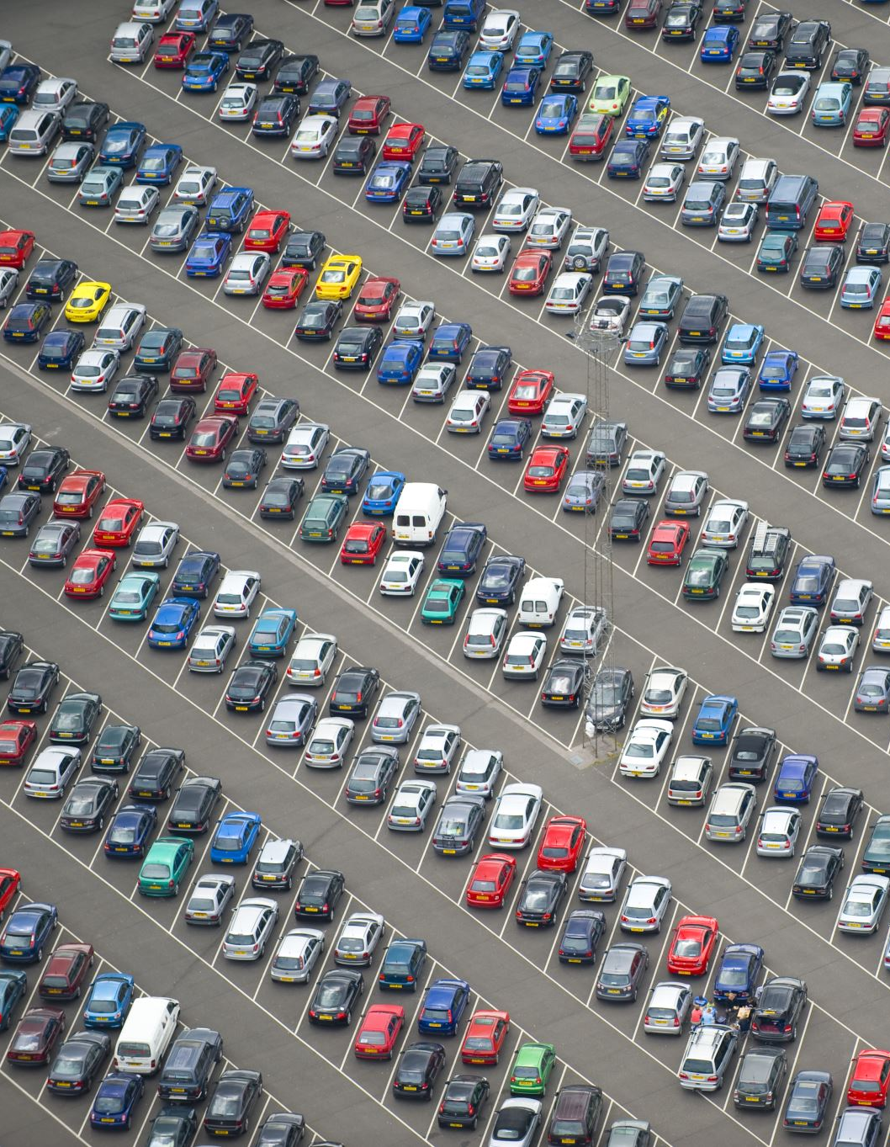
PROBLEM STATEMENT Challenges in Urban Parking Management
Manual Parking Systems: Dependence on human intervention for parking management leads to inefficiencies.
Lack of Real-Time Data: Difficulty in finding available parking spots due to the absence of real-time information.
Congestion and Time Wastage: Increased traffic congestion and time wastage as drivers search for parking.
Need for Intelligent Solutions: Growing need for smart, automated systems that can manage parking effectively.

Slide 5
PROPOSED SYSTEM INTRODUCTION
The proposed Smart-Park AI-Enhanced Parking System involves a self-governing intelligent approach to the parking management system. The system integrates computer vision in real time with the help of predictive analytics and natural language processing for user interaction.
The three major modules that the core architecture of Smart-Park is divided into include the computer Vision Module, Predictive Analytics Module, and User Interaction Module. The computer Vision Module is based on the use of ultralytics's YOLO v5 model combined with PIL, a deep learning framework optimized for real-time object detection, thereby it is fast and accurate. This module performs real-time video analysis to identify available parking spots.
The Predictive Analytics Module shall look into historical occupancy and identify trends over time to predict parking demand. Supervised learning models are used to inform estimation of the future availability in terms of peak hours, seasonality of demand, and specific location usage.
The User Interaction Module primarily focuses on making the system accessible and user-friendly. It integrates with NLP libraries, which include spaCy and NLTK. These tools grant the module a chatbot interface from which users can merely send voice or text inputs to SmartPark.

Slide 6
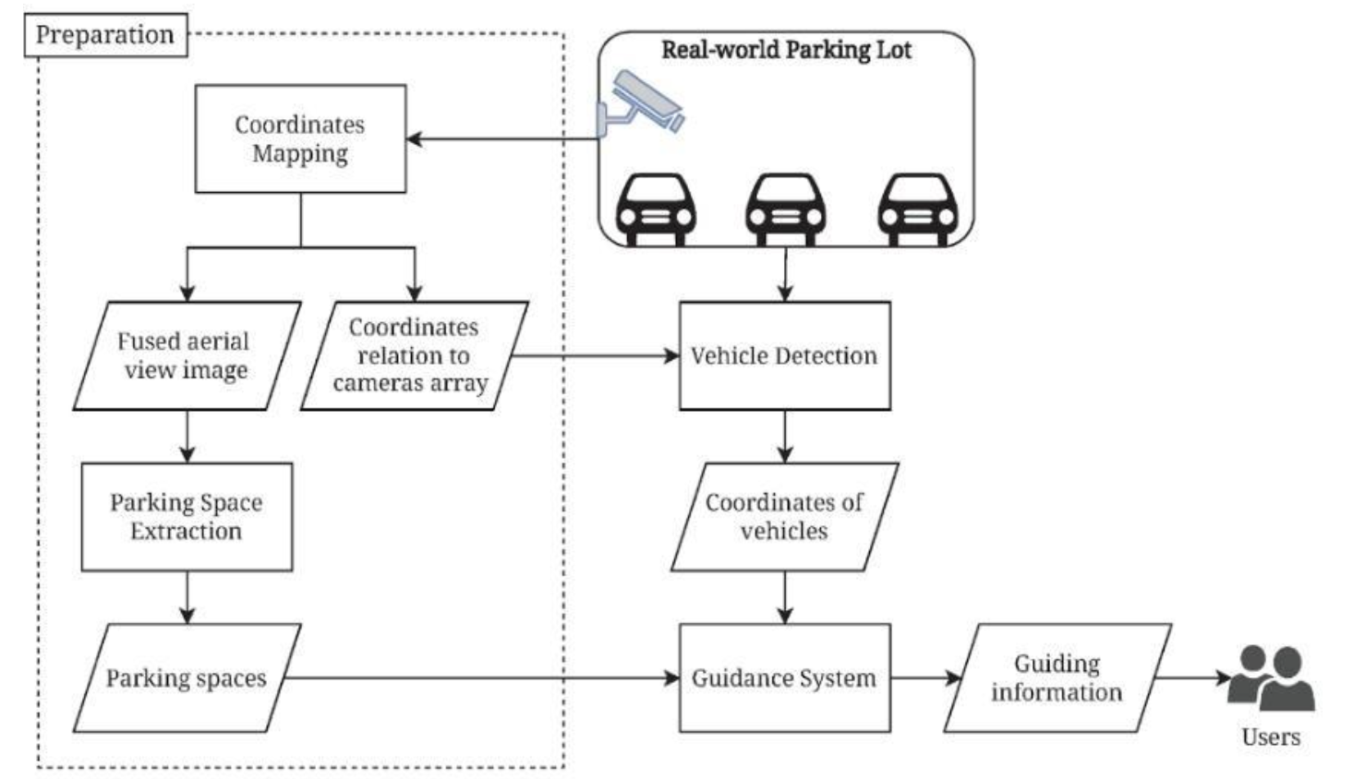
PROPOSED SYSTEM DIAGRAM

Slide 7
LIST OF MODULES
A) Computer Vision Module:
Technology: YOLO v5 Model from Ultralytics and PIL (Python Imaging Library):
Function: Real-time video analysis to detect and report available parking spots.
B) Predictive Analytics Module:
Technology: Python with Data Normalization (Supervised Learning).
Function: ML models trained on historical parking data to forecast availability.
C) User Interaction Module:
Technology: Python with NLP libraries like spaCy or NLTK.
Function: Chatbot integrated into vehicle’s Infotainment touchscreen system for user queries and guidance and provides user interface for parking spot availability and booking.

Slide 8
LIST OF MODULES
A) Computer Vision Module
Technology Used:
YOLO v5 (You Only Look Once): This is a popular, fast, and accurate deep learning model for object detection developed by Ultralytics. YOLO v5 is particularly well-suited for real-time applications because it can analyze entire images in a single pass, making it efficient for tasks like identifying objects in video streams.
PIL (Python Imaging Library): PIL, often used in Python-based image processing, handles image manipulation tasks like loading, resizing, and converting image formats. It can be useful in pre-processing and post-processing images around YOLO’s detections.
Function:
This module performs real-time video analysis to detect available parking spots. By processing live camera feeds, it can identify which spots are currently open or occupied. YOLO's object detection capabilities make it possible to locate and classify areas as "occupied" or "vacant" with high accuracy.
The module then reports this information, potentially sending updates to other modules, like a central dashboard or user interface.

Slide 9
LIST OF MODULES
B) Predictive Analytics Module
Technology Used:
Python: The programming language used here for implementing machine learning algorithms and managing data.
Data Normalization: In machine learning, data normalization ensures that all input data is on a similar scale, which improves model performance and learning speed.
Supervised Learning Models: These are trained on labeled historical data to recognize patterns. In this case, supervised learning algorithms could analyze past parking data, allowing the system to predict availability based on trends and patterns.
Function: This module forecasts future parking availability based on historical data patterns. For instance, it might predict that a certain area will likely have more open spots at a specific time of day. Using historical parking data (like occupancy rates over time), the ML model generates predictions, which could be relayed to users to help them plan their parking in advance.

Slide 10
C) User Interaction Module
Technology Used:
Python with NLP Libraries (e.g., spaCy or NLTK): These libraries enable Natural Language Processing (NLP), allowing for understanding and generating human language. NLP is crucial for building chatbots capable of interpreting user questions and responding meaningfully.
The Chatbot would be designed to respond to user queries related to parking availability, provide guidance, and offer reservation options if integrated with a booking system.
Function:
This module enables interaction with users through a chatbot. It answers questions about parking availability, offers guidance to navigate to the available spots, and provides booking options when applicable.
Additionally, it serves as a user interface, allowing drivers to view real-time parking availability information and interact with the predictive analytics data for future parking availability forecasts.

Slide 11
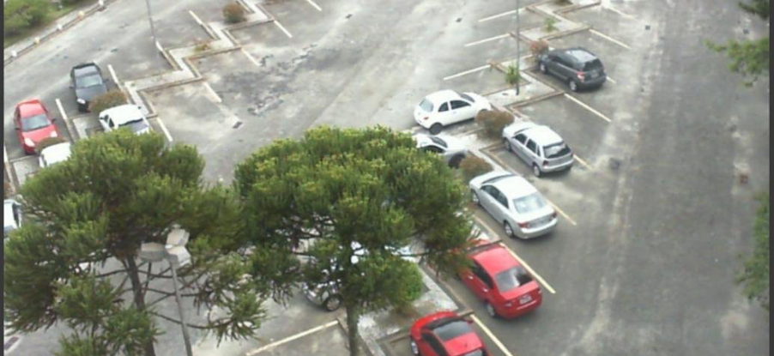
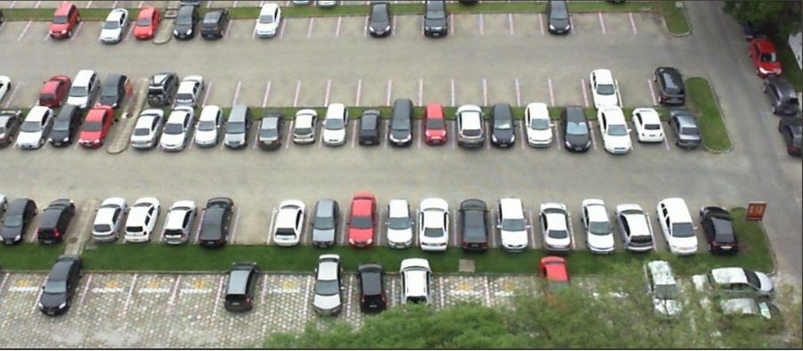
RESULTS
Input images -

Slide 12
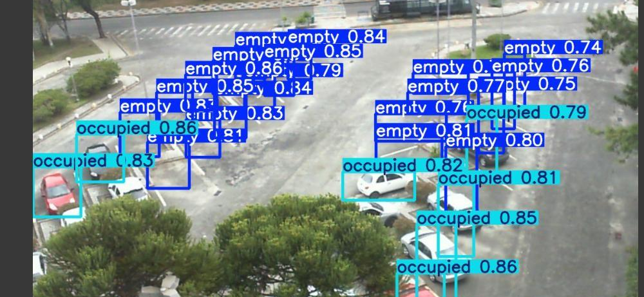
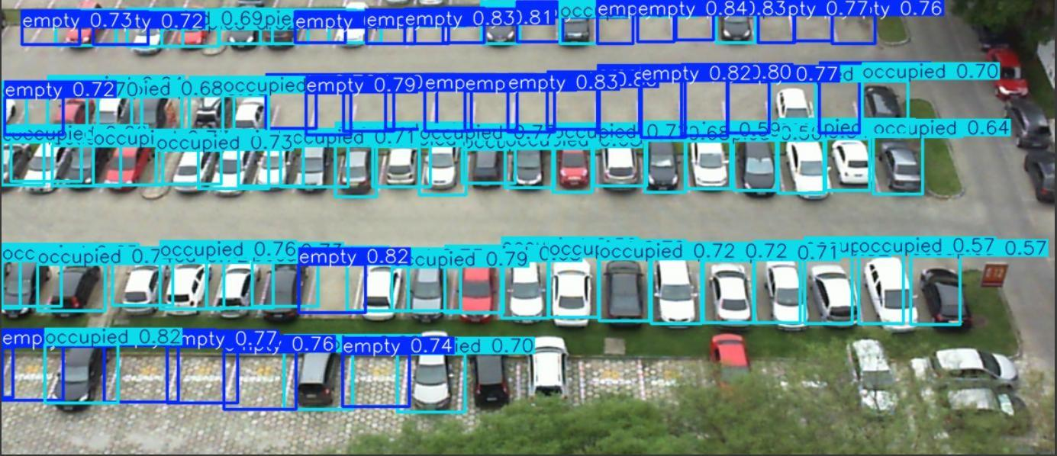
RESULTS
Output images -

Slide 13
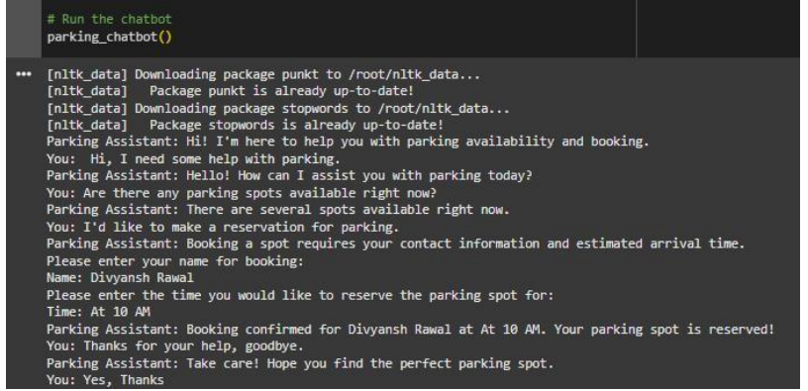
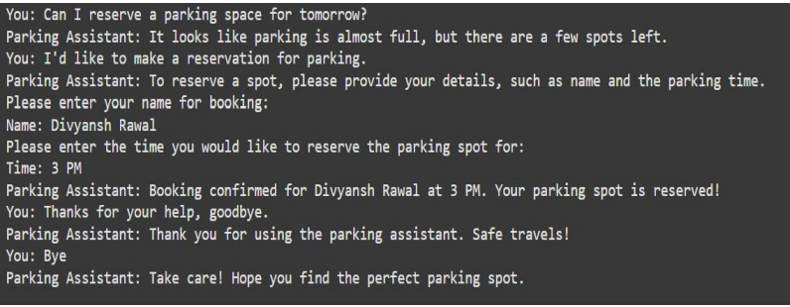
RESULTS
Cvdsf
Chatbot Interactions
Chatbot interactions -

Slide 14
FINDINGS
Model Performance Results
Object Detection Results -
Intersection over Union (IoU): 0.85 - An IoU of 0.85 indicates excellent spatial overlap between predicted and actual bounding boxes, demonstrating strong localization capabilities. It shows the model is effective at accurately detecting parking spots with minimal error.
Mean Average Precision (mAP): 0.9 A mAP of 0.9 reflects high precision and recall, suggesting that the object detection model reliably identifies occupied and vacant parking spots, even in varied lighting and weather conditions.
Frame Processing Time: < 0.05 seconds A frame processing time of less than 0.05 seconds confirms the model's suitability for real-time applications, meeting the latency requirements for dynamic parking systems.
False Positive Rate & False Negative Rate: < 5%: < 5% Both metrics being under 5% signifies the model's reliability, ensuring it minimizes errors that could mislead users, such as mistaking an occupied spot for a vacant one or vice versa.
Real-time Processing: The model completes the processing of each frame within 0.05 seconds; hence, it can be used for real-time update purposes. Drivers get information about the parking spots available within nearly real-time order, which enhances their experience and saves time spent in searching .

Slide 15
FINDINGS
Model Performance Results
Object Detection Results -
Prediction Accuracy: Models such as ARIMA and Random Forest reach low error rates as MAE is about 5% and RMSE is about 7%, which points to the fact that the predictive analytics model can very accurately be able to foresee parking availability.
Response Accuracy: The NLP model is very accurate for capturing user intent, for which it has gained an F1-score of 0.92. Hence, the chatbot can perform very well to interpret the queries related to parking with adequate information.
Response Time: It responds within 1-2 seconds. This will surely make the interactions smooth enough for the users. Rapid response time makes the use practical for real-time scenarios in which drivers can make an immediate decision.
Predictive Analytics Results -
Mean Absolute Error (MAE): ~5% A ~5% MAE indicates the model’s predictions for parking availability are close to actual values, signifying good performance in capturing real- world patterns.
Root Mean Squared Error (RMSE): ~7% The ~7% RMSE complements the MAE by emphasizing the impact of larger prediction errors. The relatively low RMSE confirms the model maintains accuracy even when errors occur.
Forecasting Time: < 0.2 seconds A prediction time under 0.2 seconds is optimal for delivering near-instantaneous updates to users, aligning with real-time operational demands.

Slide 16
CONCLUSION AND FUTURE WORK
Smart-Park: AI-Enhanced Digital Parking System is the greatest leap toward solving the biggest issues of growing urban parking management. By incorporating the latest computer vision, machine learning, and natural language processing, the smart system optimizes parking processes while cutting congestion and enhancing the user experience. It combines real-time spot detection by YOLO-based models with predictive analytics powered by historical data, and it offers a reliable and scalable solution for urban environments where demand for parking continues to grow.
SmartPark’s ability to detect available parking spots in real-time using YOLO v5 and computer vision algorithms exemplifies the practical application of AI in solving everyday problems. By utilizing deep learning models trained on video data, the system ensures accurate identification of vacant and occupied spots, reducing driver frustration and traffic congestion.
The inclusion of predictive analytics further enhances the system's utility, as it allows users to anticipate parking availability based on historical and real- time data, making it possible to plan journeys more efficiently
It is therefore in conclusion that Smart-Park presents an innovative approach to parking challenges in cities by providing a system that at one and the same time addresses drivers', operators', and urban planners' needs.
The newest version of Smart-Park also does reflect potential AI-driven solutions related to the nearer real-time detection of spots, predictive analytics, and user-friendly interfaces. However, there are numerous opportunities in future improvements and expansions to use its full capacities and applicability to varied types of urban environments.
Advanced Use of Sophisticated Technologies - Future versions of Smart-Park can use advanced versions of machine learning and deep learning algorithms for enhanced predictive analytics.
Advanced User Interaction Features - The user interaction module would be further improved with AI-driven personalization, for instance dynamic parking based on preferences or history.
Scalability and Worldwide Roll-Out - It is crucial to scale the SmartPark system and deploy it in different geographies and under differing parking scenarios, such as multi-level garages, street-side parking, and rural areas.

Slide 17
REFERENCES
Xiang, X., Lv, N., Zhai, M., El Saddik, A.: Real-time parking occupancy detection for gas stations based on haar-AdaBoosting and CNN. IEEE Sens. J. 1 (2017). https://doi.org/10.1109/jsen.2017.2741722
Valipour, S., Siam, M., Stroulia, E., Jagersand, M.: Parking-stall vacancy indicator system, based on deep convolutional neural networks, pp. 655–660 (2016). https://doi.org/10.1109/wf-iot.2016.7845408
AI-based Smart Parking Solutions: Parking Telecom Blog. Parking Telecom. (2020, April 1). Retrieved December 13, 2022. https://doi.org/10.1109/tits.2013.2252428
Geng, Y., Cassandras, C.G.: New “smart parking” system based on resource allocation and reservations. IEEE Trans. Intell. Transp. Syst. 14 (2011). https://doi.org/10.1109/tits.2013.2252428
AI-based Smart Parking Solutions: Parking Telecom Blog. Parking Telecom. (2020, April 1). Retrieved December 13, 2022. https://parkingtelecom.com/en/ai-based-smart-parking-solutions/

Slide 18
REFERENCES
V. Paidi, H. Fleyeh, J. Håkansson, R.G. Nyberg Smart parking sensors, technologies and applications for open parking lots: a review IET Intell. Transp. Syst., 12 (8) (Oct. 01, 2018), pp. 735-741. https://doi.org/10.1049/iet-its.2017.0406
N. Zhong, J. Cao, Y. Wang Traffic congestion, ambient air pollution, and health: evidence from driving restrictions in Beijing J. Assoc. Environ. Resour. Econ., 4 (3) (Sep. 2017), pp. 821-856. https://www.journals.uchicago.edu/doi/10.1086/692115
J.A. Vera-Gómez, A. Quesada-Arencibia, C.R. García, R.S. Moreno, F.G. Hernández An intelligent parking management system for Urban areas Sensors (Switzerland), 16 (6) (Jun. 2016), p. 931. https://www.mdpi.com/1424-8220/16/6/931
H. Chien Yee, Y. Rahayu Monitoring parking space availability via zigbee technology Int. J. Futur. Comput. Commun., 3 (6) (Dec. 2014), pp. 377-380. https://www.ijfcc.org/index.php?m=content&c=index&a=show&catid=50&id=623
J. Yang, J. Portilla, T. Riesgo Smart parking service based on wireless sensor networks IECON 2012 - 38th Annual Conference on IEEE Industrial Electronics Society (2012), pp. 6029-6034. https://ieeexplore.ieee.org/document/6389096

Slide 19
THANK YOU

